Slide 1









Superstore SALES
Project
R3-Data Analyst Specialist CAI3_DAT1_G2
Under supervision of
Date
ENG. Ahmed Samir
December, 2025

Slide 2
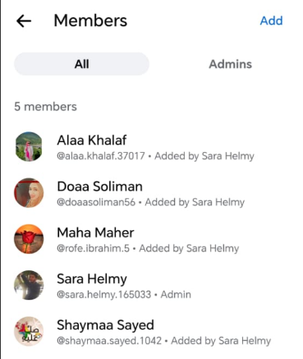


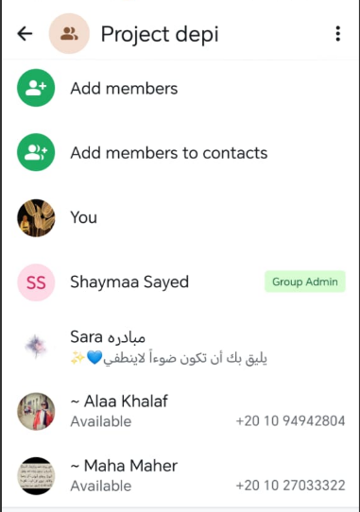

Team members:
Sara Helmy (leader)
Alaa Khalaf
Doaa Soliman
Shaimaa sayed
Maha Maher

Slide 3

Table of content
Project overview & Executive summary
Data preparation and transformation
Project Analysis step
Visualization
Recommendation

Slide 4
Table of content
Project overview & Executive summary

Slide 5

Project Overview
Turning raw sales data into dynamic, insightful dashboards that empower better decisions.
This project enhances visibility, uncovers performance trends, and supports strategic actions that drive measurable business growth

Slide 6
EXECUTIVE
SUMMARY
Turn original data set that Include one sheet with 18 columns & 9800 rows
with visualization into interactive dashboards
Products
Total products # 793
Sales
Total sales 2.2 M
Orders # 4922
Top sales per region: west, east
Shipping
AV.shipping time 4 days
32% delay, 68% on time
Total categories # 3
Total
subcategories # 17
Total # 793
Segment
52% consumer , 30% corporate, 19% home office
Customers

Slide 7
Table of content
Project overview & Executive summary
Data preparation and transformation

Slide 8




Data preparation
&
transformation
Data cleaning ensured accuracy and consistency by removing errors, duplicates, and invalid values before analysis. Normalization then organized the cleaned data into structured tables (1NF–3NF), reducing redundancy and improving data integrity for efficient querying
Data cleaning (excel, SQL, Python)
Data Cleaning
Remove duplicate records
Handle missing values appropriately
Standardize date, text, and numeric formats
Ensure consistency across all datasets
Product name standardization
Product name with more than 1 ID (Group BY, filter, replace)
Clean white spaces by Remove leading/trailing.

Slide 9
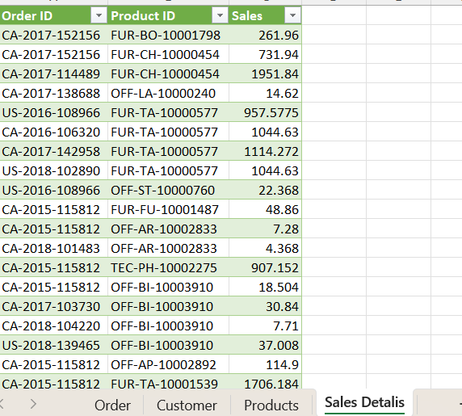
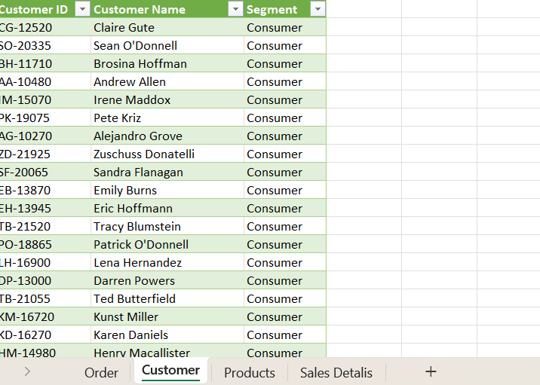
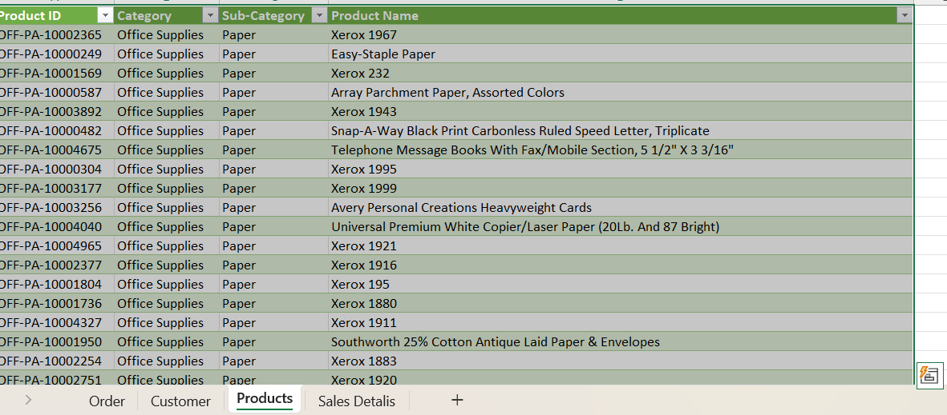
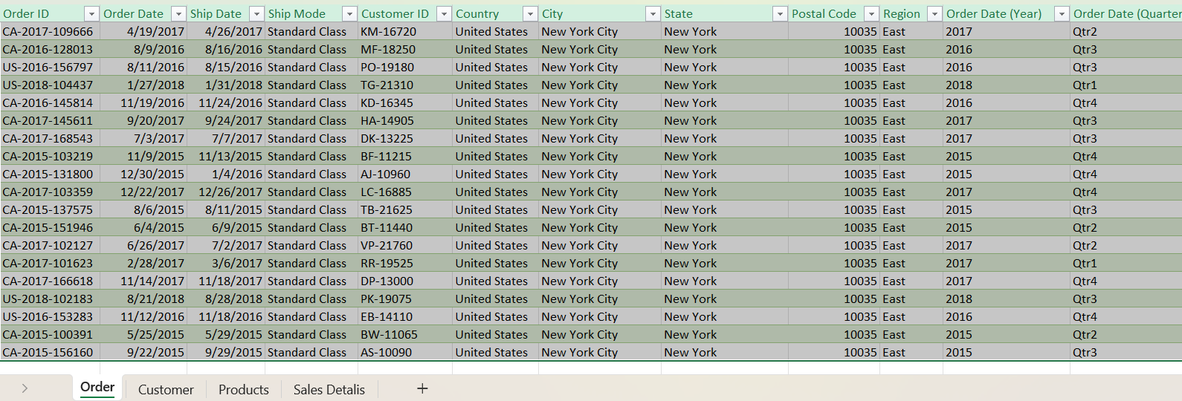
Overview after normalization

Slide 10
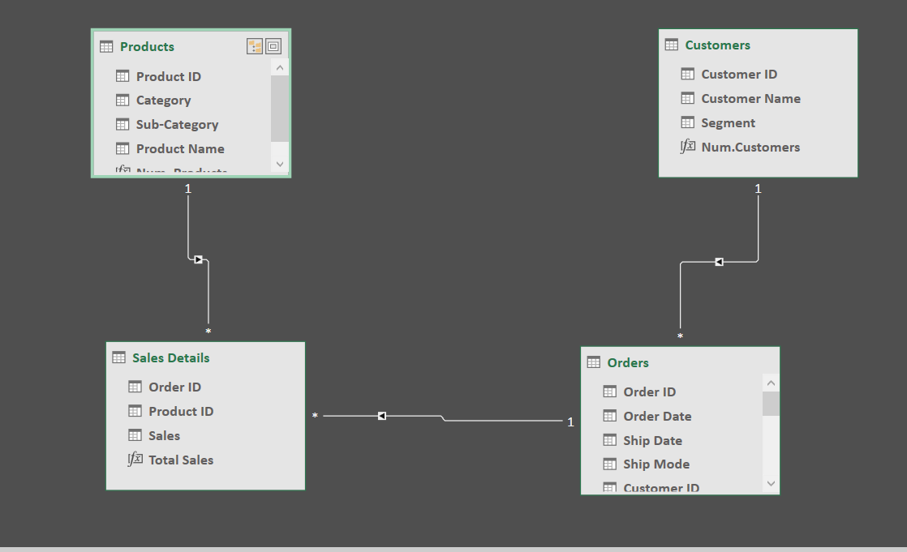
Data Model

Slide 11

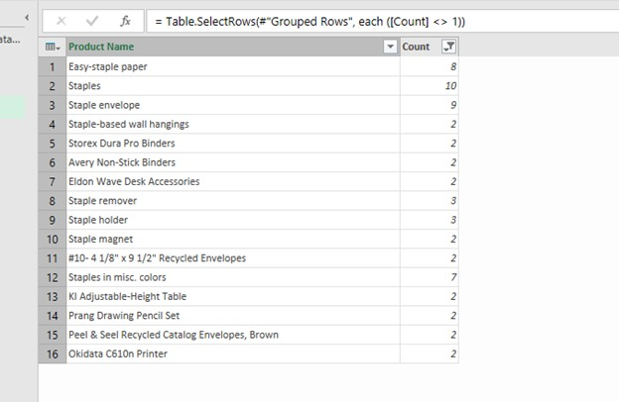
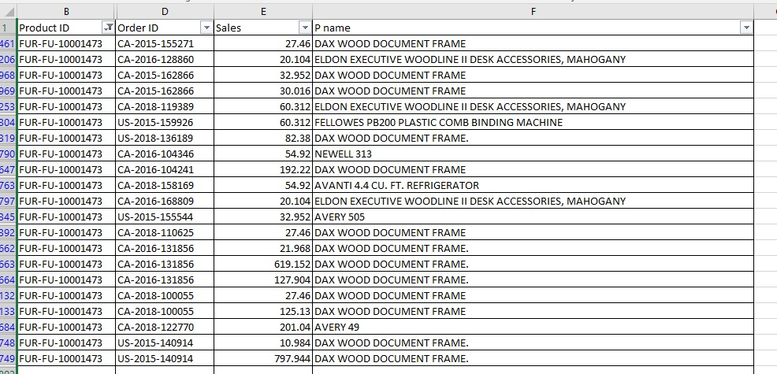
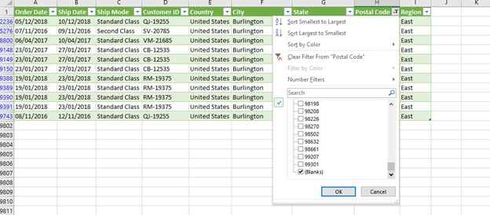
Data cleaning screenshots
Product ID & Name repetition
Missing values
Delays in production and distribution are causing stock shortages, which negatively impacts sales and customer satisfaction.
Sales processes are inefficient, causing delays and missed opportunities, especially during peak demand.
SHIFTS IN CONSUMER BEHAVIOR

Slide 12


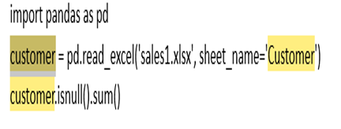
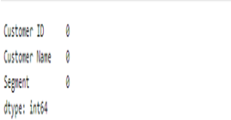

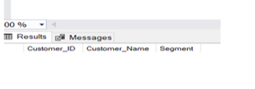

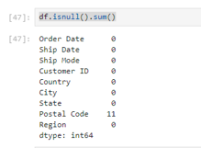
Data cleaning screenshots
SQL
Python
Delays in production and distribution are causing stock shortages, which negatively impacts sales and customer satisfaction.
Sales processes are inefficient, causing delays and missed opportunities, especially during peak demand.
SHIFTS IN CONSUMER BEHAVIOR

Slide 13



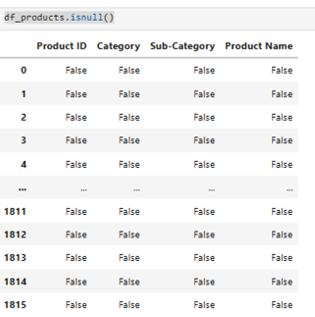
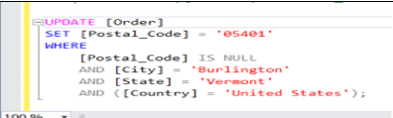


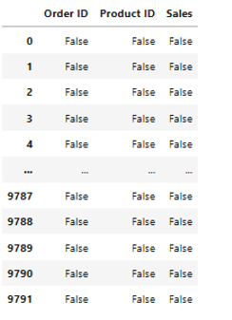
Data cleaning screenshots
SQL
Python
Sales processes are inefficient, causing delays and missed opportunities, especially during peak demand.
SHIFTS IN CONSUMER BEHAVIOR

Slide 14
Table of content
Project overview & Executive summary
Data preparation and transformation
Project Analysis step

Slide 15
Data preparation
&
transformation
Data analysis
Dataset Segmentation: Sales data was categorized into four key areas: Product, Customer, Shipping Performance, and Sales, ensuring a structured approach for analysis.
Focused Analysis: Each category was examined individually to identify trends, patterns, and areas of opportunity.
Calculated fields: to enhance information insights and analysis
Insights Generation: Analyzed data helped uncover customer preferences, top-performing products, and potential inefficiencies in shipping.
Actionable Recommendations: Findings were translated into strategic recommendations for sales improvement, inventory management, and operational efficiency.
Data-Driven Decisions: Organized insights support decision-making, enabling proactive planning and measurable business impact

Slide 16
SALES
Analysis
Tolls
Data analysis using SQL, Excel, and Python for data verification provides a powerful, end-to-end approach for transforming raw datasets into actionable insights. SQL structures and queries the data, Excel enables quick exploration
and visualization, and Python automates advanced analytics, creating
a seamless workflow for accurate, scalable decision-making

Slide 17

Sales analysis – Sales insights
Total sales and total order numbers
Total sales per quarter
Order numbers per quarter
Sales & order numbers per week days
Sales & order numbers per sales range
Sales & order numbers per sales region
High sales zone

Slide 18

Sales analysis – Products insights
Total number of categories, subcategories and products
Top 5 subcategory per sales
Less 5 subcategory per sales
Top 5 products per sales
less 5 products per sales
% of each category & subcategory per sales

Slide 19

Sales analysis – Shipping time & delivery performance insights
Average shipping time
Total delay & on time percentage
Shipping days delay per region
Delays per ship mode
Average shipping time per shape mode

Slide 20

Sales analysis – Customers insights
Total number of customers
Customer loyalty
Customer numbers per quarter
Customer per segment
Average shipping time per shape mode

Slide 21
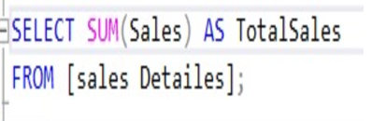
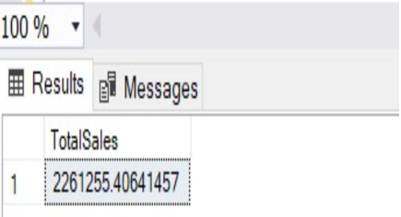
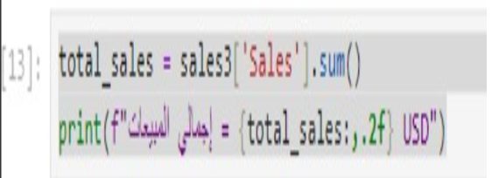
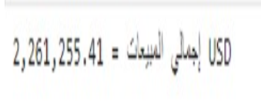


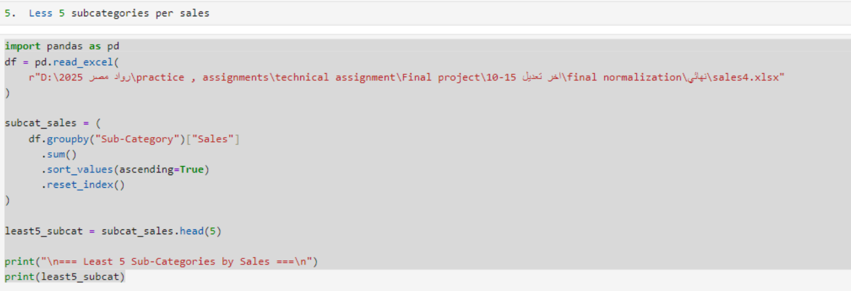
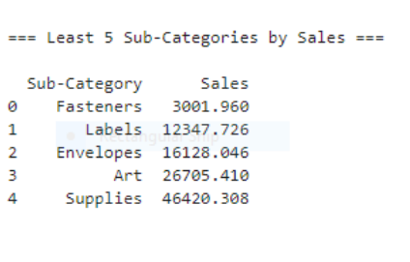
Data analysis screenshots - sales
SQL
Python
Sales processes are inefficient, causing delays and missed opportunities, especially during peak demand.
SHIFTS IN CONSUMER BEHAVIOR

Slide 22
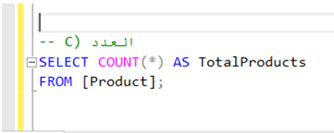
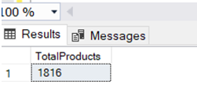
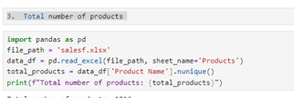

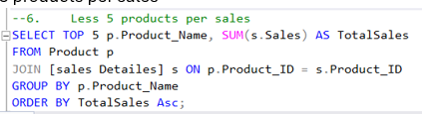
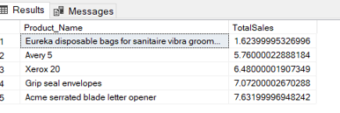
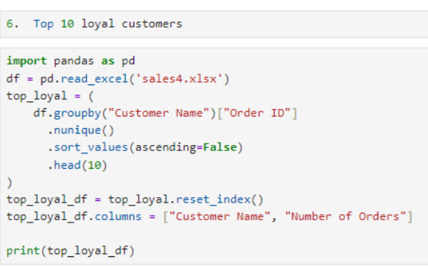
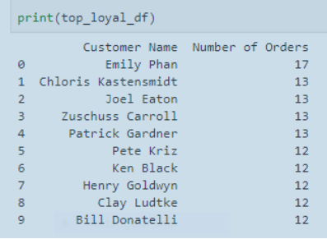
Data analysis screenshots - Products
SQL
Python

Slide 23


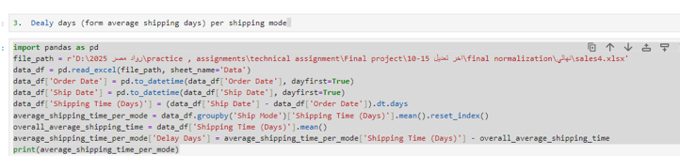
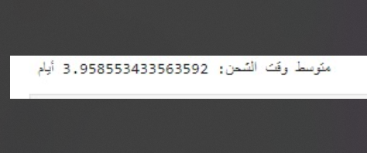
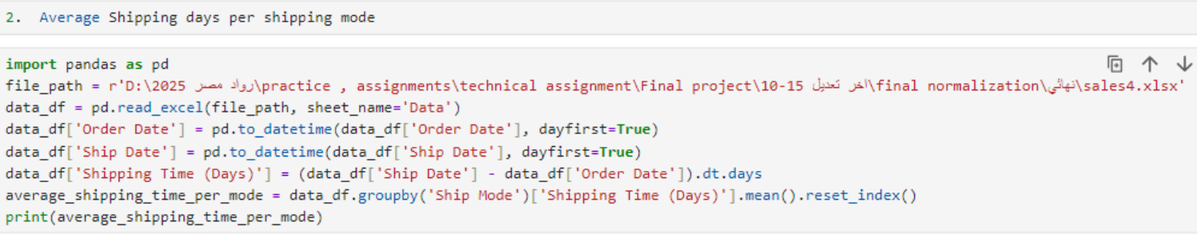
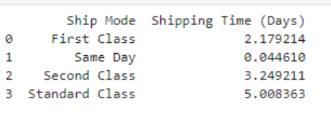
Data analysis screenshots - Shipping time & delivery performance
SQL
Python

Slide 24


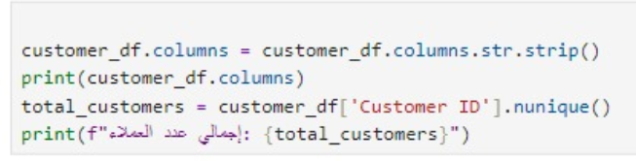
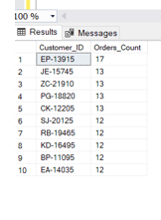
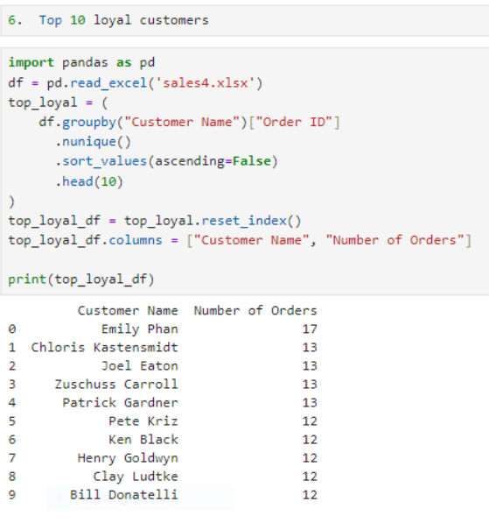
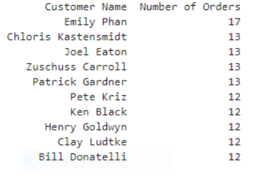
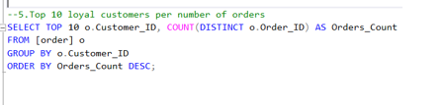
Data analysis screenshots - Customers
SQL
Python

Slide 25
Table of content
Project overview & Executive summary
Data preparation and transformation
Project Analysis step
Visualization

Slide 26
Data
Visualization
📊 Product, Customer, Sales & Shipping: Visualized for clarity
📈 Trends & Patterns: Top performers & regional insights
🎯 KPIs Tracking: Monitor sales and shipping efficiency
🖱️ Interactive Dashboards: Explore data dynamically
💡 Actionable Insights: Drive strategic decisions & recommendations

Slide 27
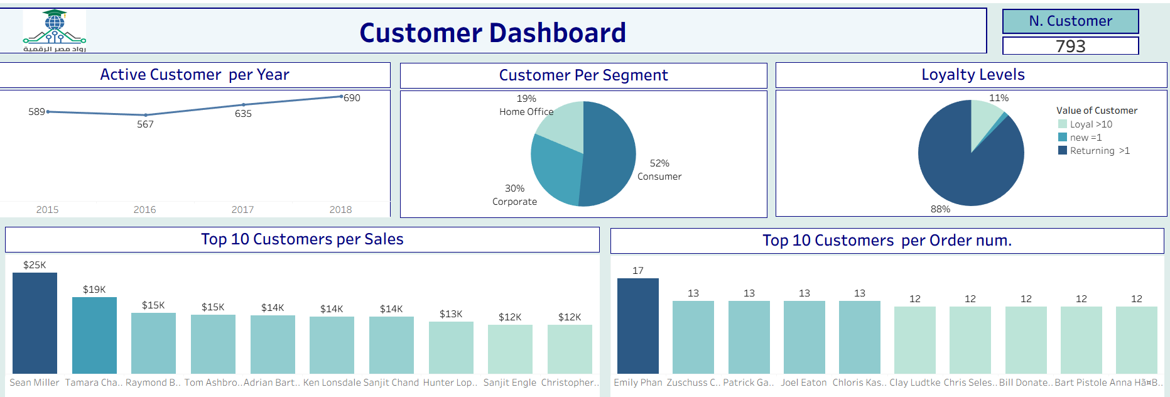
Dashboard – Sales Analysis Insights GitHub Link https://github.com/sarahelmyto/Depi-project-G.C

Slide 28
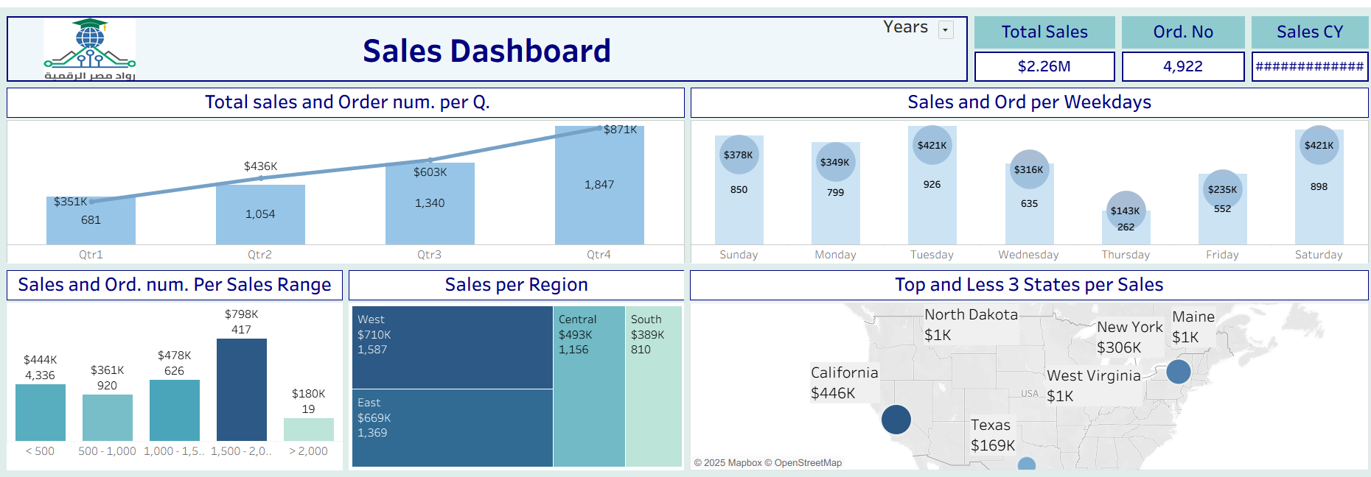
Dashboard – Sales Analysis Insights GitHub Link https://github.com/sarahelmyto/Depi-project-G.C

Slide 29
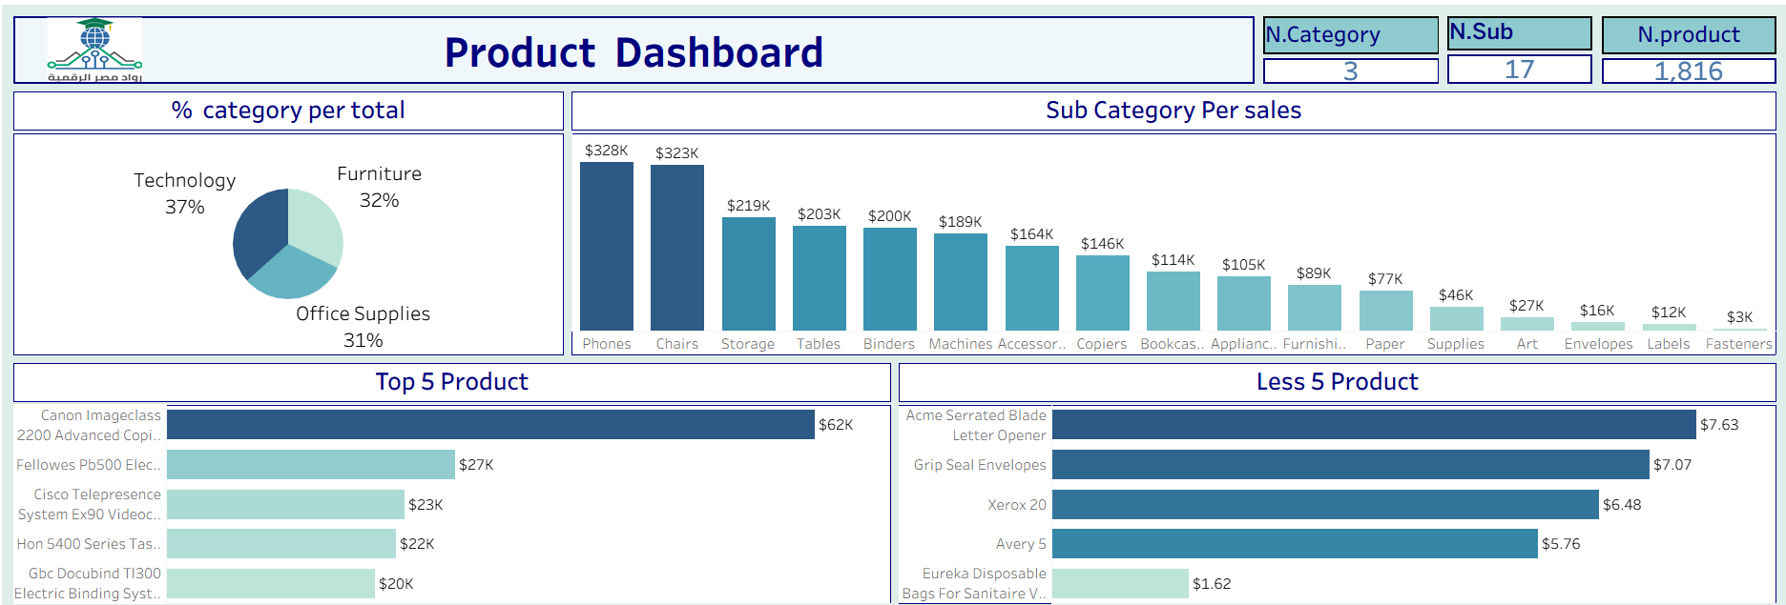
Dashboard – Sales Analysis Insights GitHub Link https://github.com/sarahelmyto/Depi-project-G.C

Slide 30
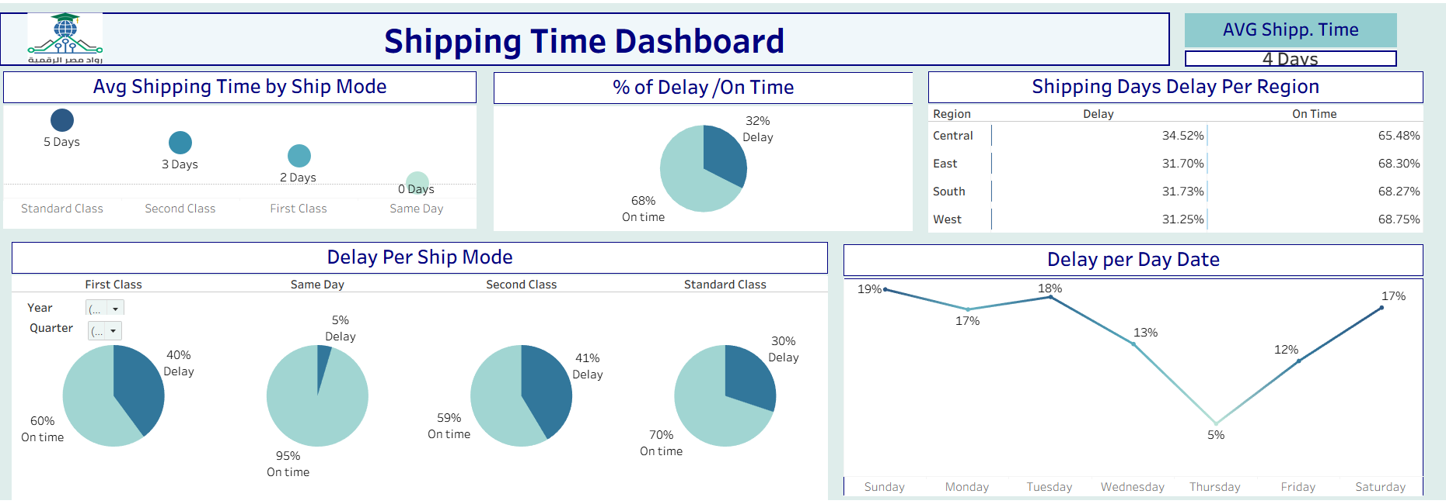
Dashboard – Sales Analysis Insights GitHub Link https://github.com/sarahelmyto/Depi-project-G.C

Slide 31
Table of content
Project overview & Executive summary
Data preparation and transformation
Project Analysis step
Visualization
Recommendation

Slide 32


STRATEGIC
RECOMMENDATIONS
Top Performing Products
high-revenue products and allocate marketing and inventory resources accordingly.
Consider bundling or promotional strategies for products with moderate sales but high profit margins.
Customer Segmentation
Identify loyal customers and develop targeted retention strategies.
Explore cross-selling and upselling opportunities for high-value segments

Slide 33
STRATEGIC
RECOMMENDATIONS
Regarding the peak of sales on Sunday, Saturday and Tuesday that noted with affected
the performance being with highest % of shipping delay reaching 19%, Investigate of the root cause to work on solutions.
Sales Channels & Shipping Performance
Optimize shipping processes for regions with higher delivery delays.
Strengthen high-performing channels and review underperforming ones for improvement
.

Slide 34
STRATEGIC
RECOMMENDATIONS
. Enhance low sales weekdays on Thursday, Friday ( discounts, promotions)
The less products to be investigated for client support issue, maintenance issue, upgrading (ACME serrated blade, Grip seal envelopes, xerox 20) along with bundles with top sale products.
Trends & Seasonality
Leverage historical sales patterns to plan inventory and promotions proactively.
Prepare for peak demand periods to minimize stockouts )Q3& Q4) and maximize revenue
Consider discounts, bundles, or loyalty incentives to stimulate demand (Q1 & Q2)

Slide 35
STRATEGIC
RECOMMENDATIONS
Actionable Next Steps
Conduct targeted marketing campaigns for underperforming regions or products.
Align inventory planning with demand to reduce holding costs.
Regularly review KPIs to measure the impact of implemented strategies

Slide 36

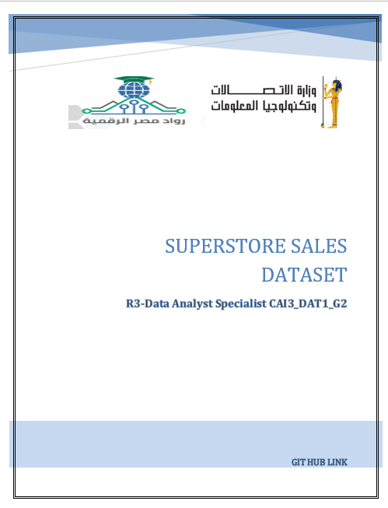
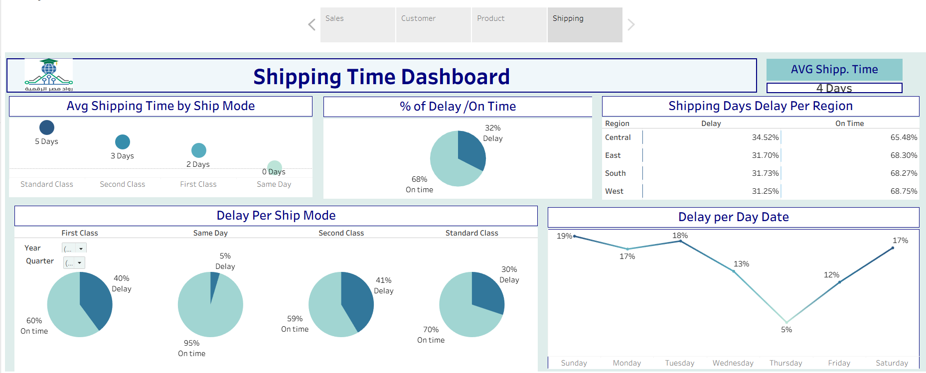

Deliverables
h
GitHub link
https://github.com/sarahelmyto/Depi-project-G.C

Slide 37


THANK
YOU
We truly appreciate your participation and interest. Should you have any further questions or need assistance, feel free to reach out. We look forward to working together towards continued success.

